Slide 1
D3.JS Visualization of data
@VLADISLAVBARANOV
Notes:
Hello, my name is Vladislav Baranov

Slide 2
VISUALIZATION OF DATA IN ANCIENT TIMES
Notes:
visualization of data is needed to more clearly provide numerical information. the visualization of human data is involved for many hundreds of years. the following slides show photos of the person's first attempts to visualize the data

Slide 3
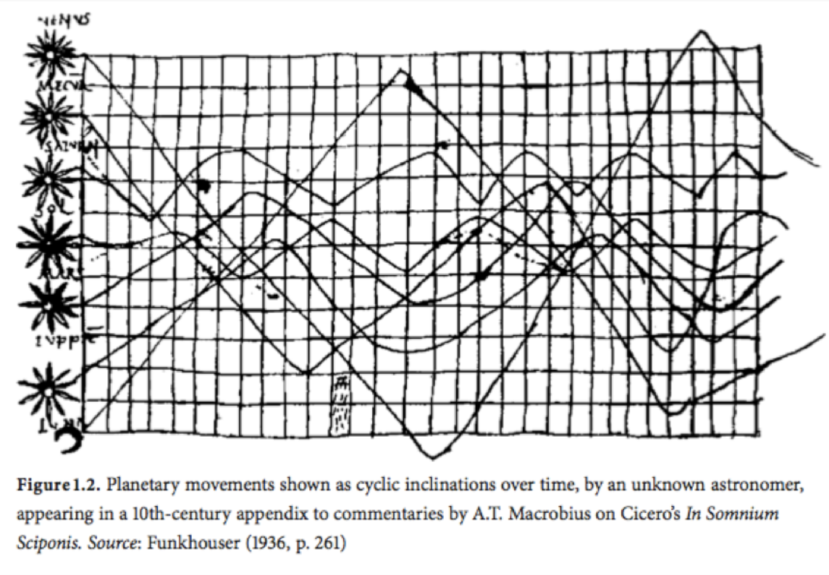

Slide 4
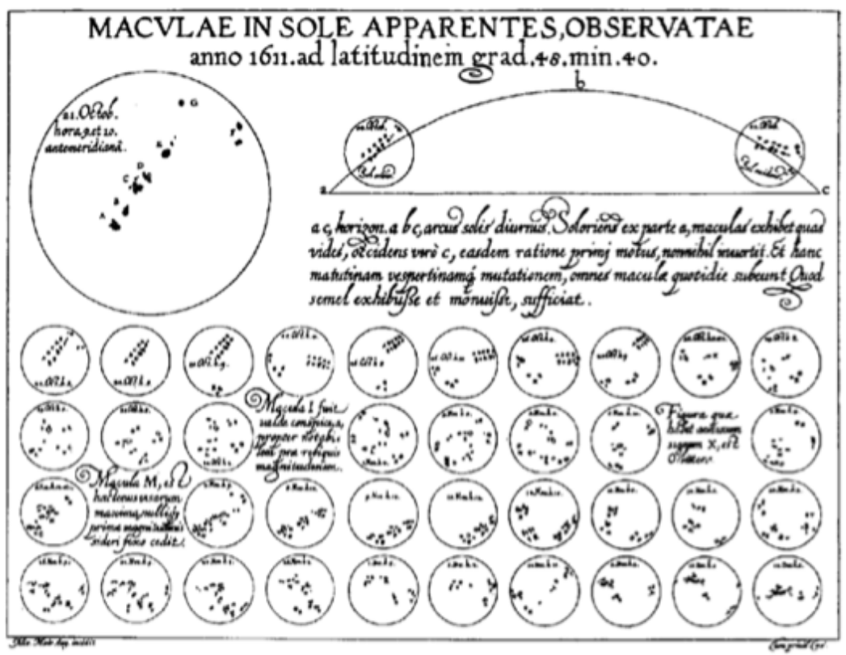

Slide 5
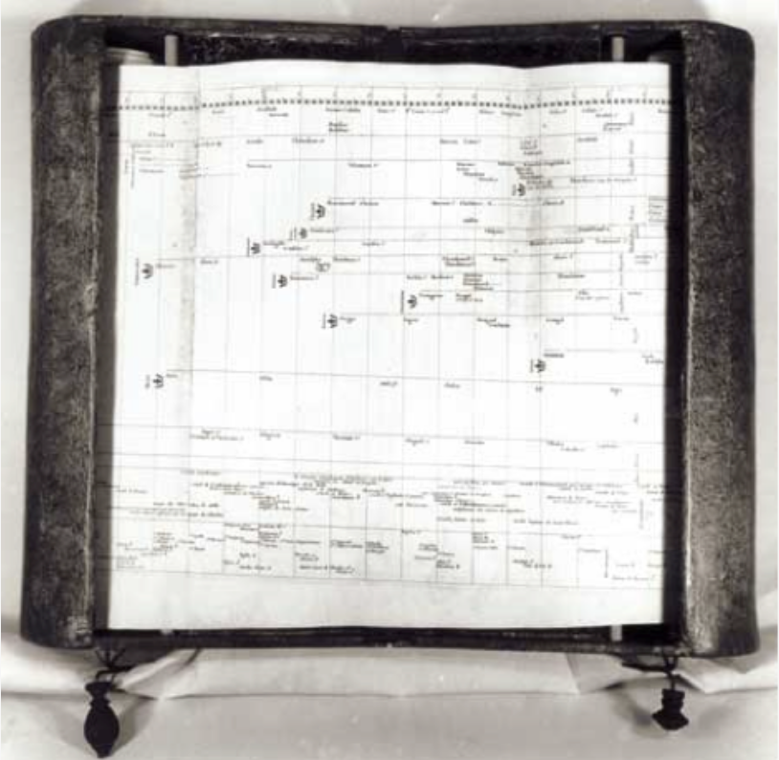

Slide 6
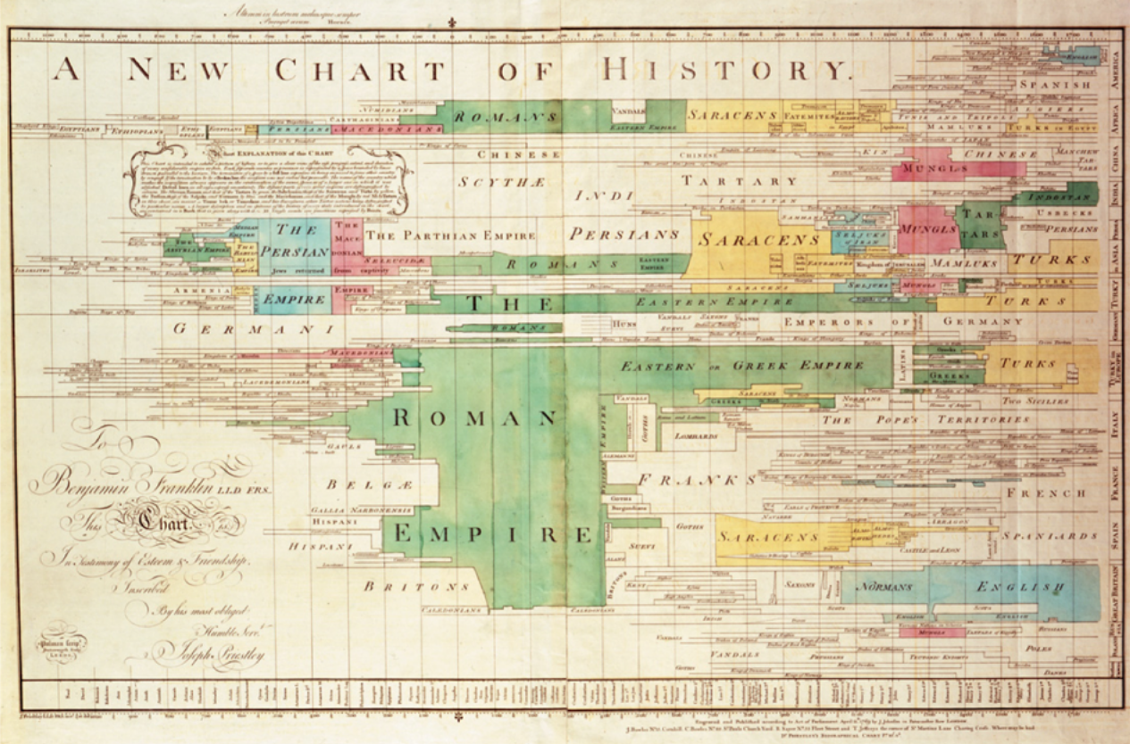

Slide 7
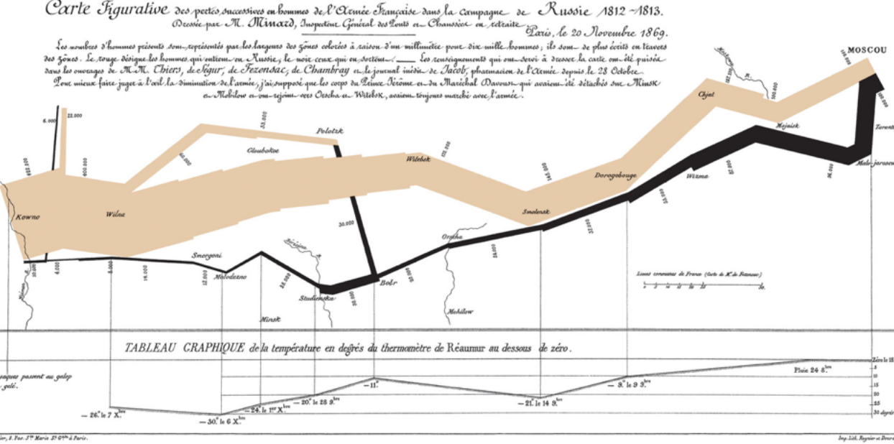
Notes:
Napoleon 1812-1813

Slide 8
VISUALIZATION OF DATA NOT SO LONG AGO
Notes:
earlier when we needed to build a diagram, we used an excel in which there are many primitive diagrams

Slide 9
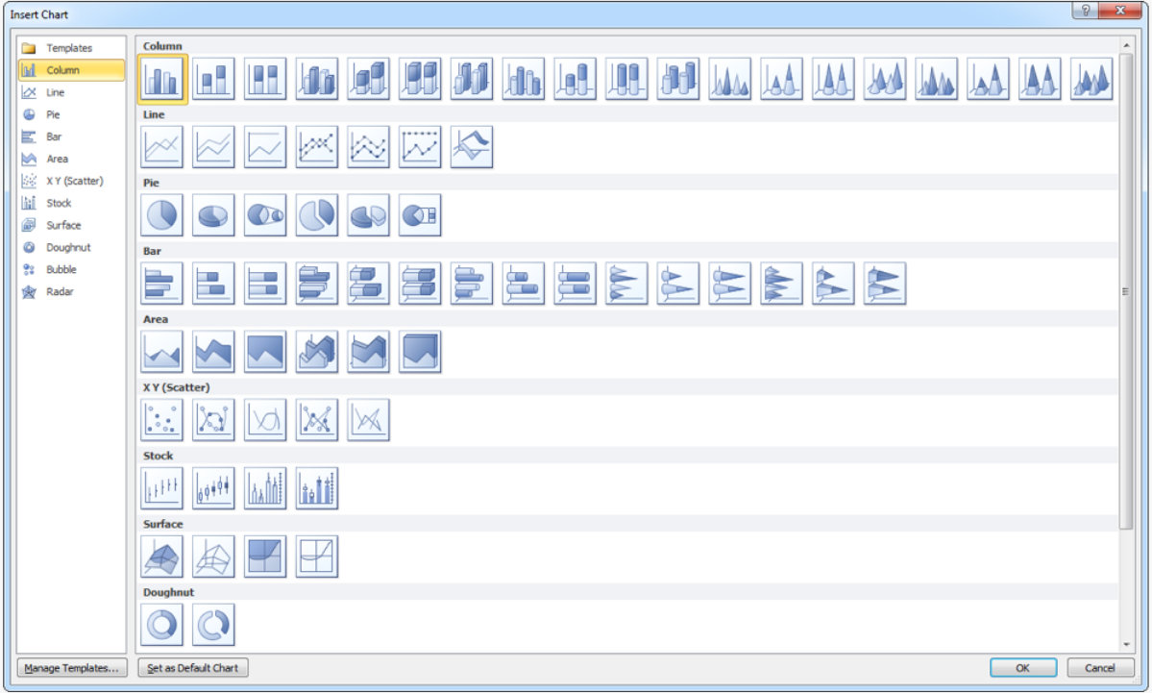
Notes:
in the Excel there is a sufficiently large number of primitive diagrams

Slide 10
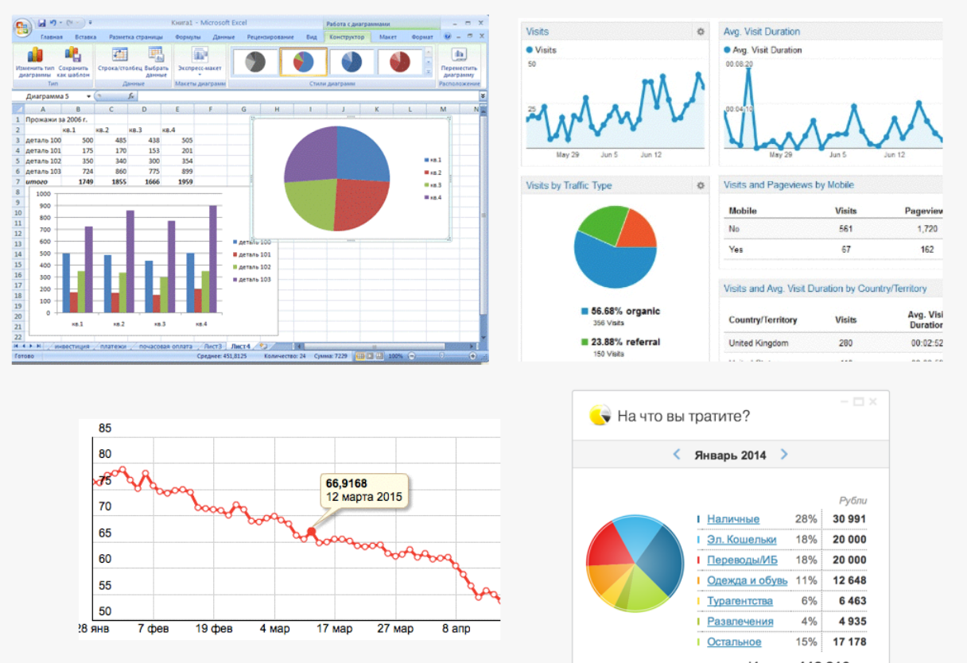

Slide 11
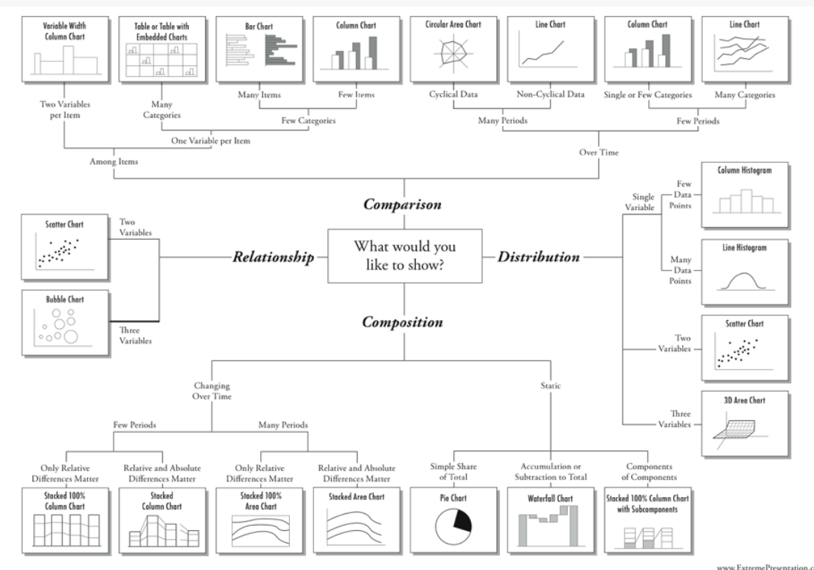
WE NEED MORE DIAGRAMS
Notes:
WE NEED MORE DIAGRAMS

Slide 12
PRESENT TIME
Notes:
progress does not stand still

Slide 13
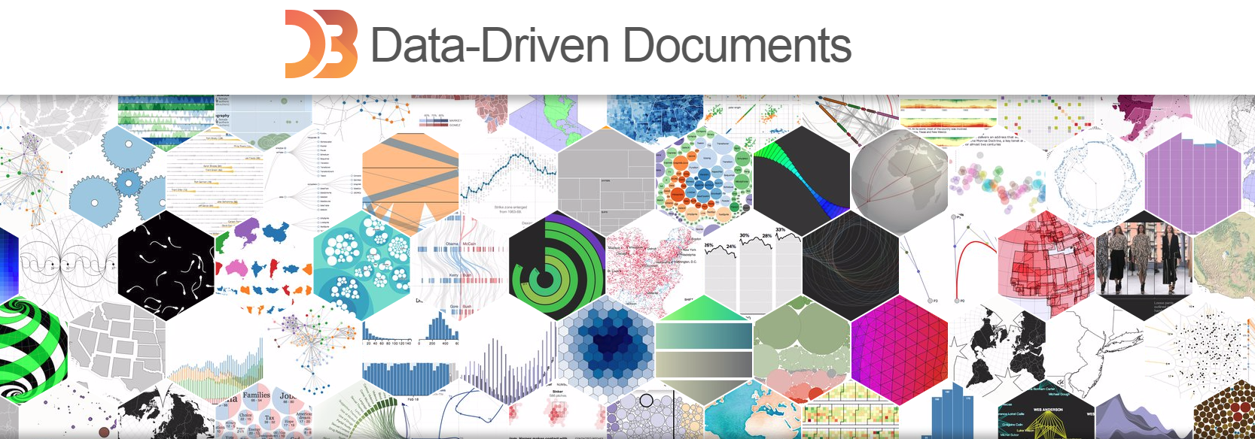
Notes:
D3.js is a JavaScript library for manipulating documents based on data. D3 helps you bring data to life using HTML, SVG, and CSS. D3’s emphasis on web standards gives you the full capabilities of modern browsers without tying yourself to a proprietary framework, combining powerful visualization components and a data-driven approach to DOM manipulation.
Introduction
D3 allows you to bind arbitrary data to a Document Object Model (DOM), and then apply data-driven transformations to the document. For example, you can use D3 to generate an HTML table from an array of numbers. Or, use the same data to create an interactive SVG bar chart with smooth transitions and interaction.
D3 is not a monolithic framework that seeks to provide every conceivable feature. Instead, D3 solves the crux of the problem: efficient manipulation of documents based on data. This avoids proprietary representation and affords extraordinary flexibility, exposing the full capabilities of web standards such as HTML, SVG, and CSS. With minimal overhead, D3 is extremely fast, supporting large datasets and dynamic behaviors for interaction and animation. D3’s functional style allows code reuse through a diverse collection of official and community-developed modules.

Slide 14
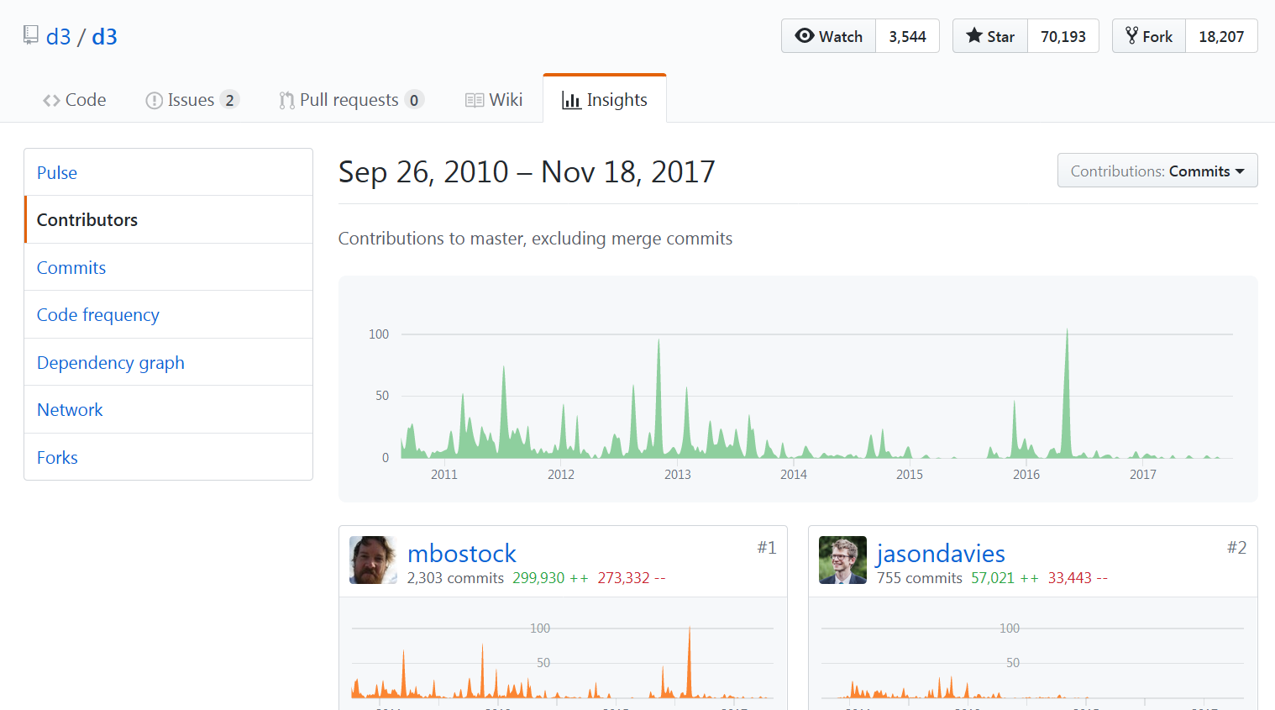
Notes:
Developer(s) Mike Bostock Initial release 6 years ago Stable release4.10.2 / 3 September 2017; 2 months ago^{[1]}

Slide 15

Notes:
Wind map

Slide 16
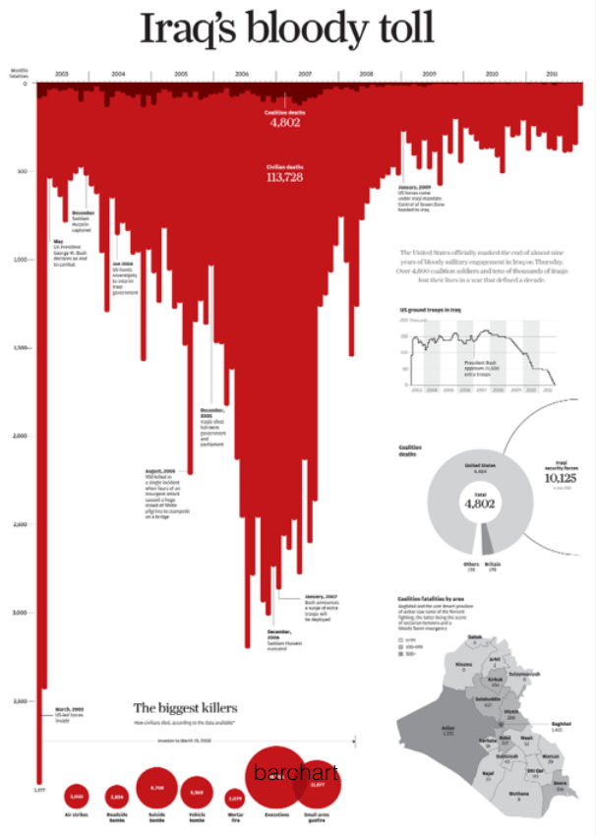

Slide 17
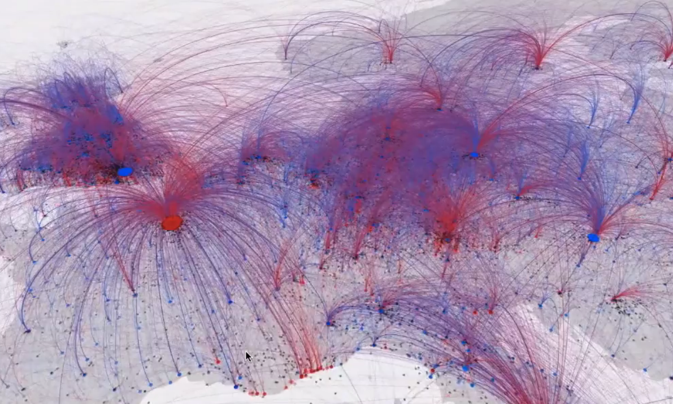

Slide 18
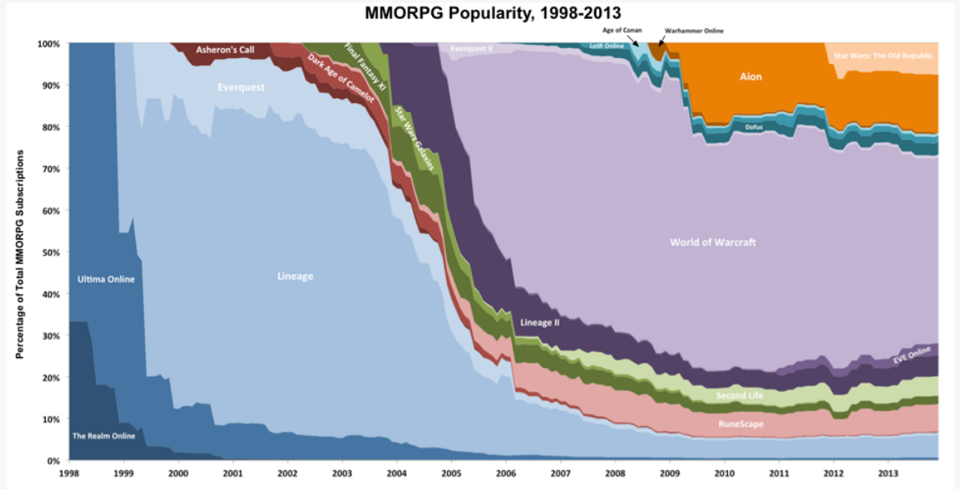

Slide 19
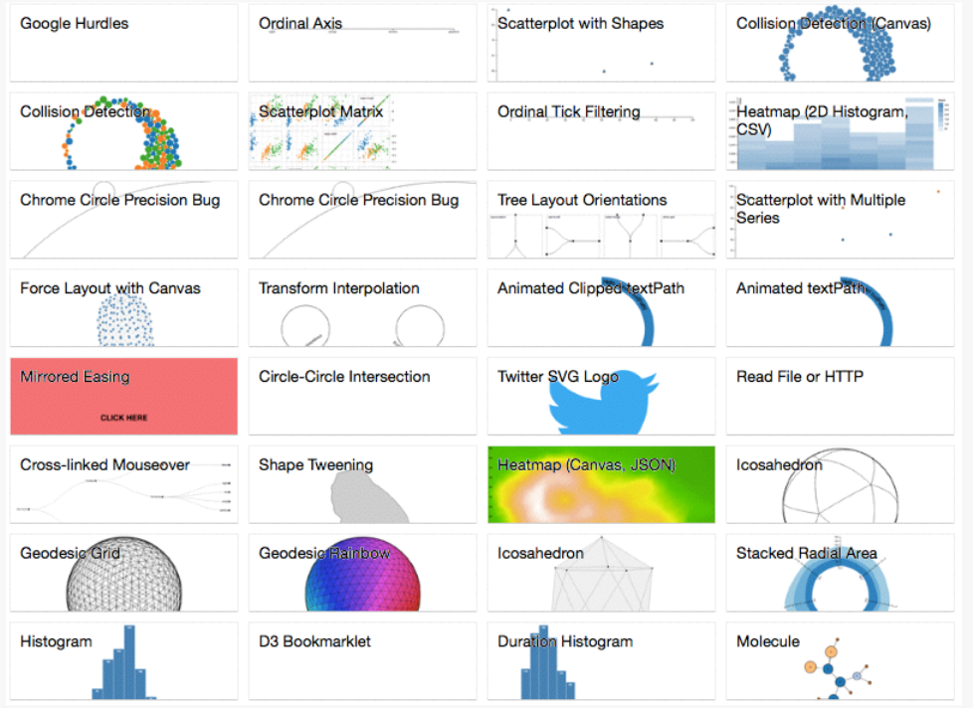
https://github.com/mbostock/d3/wiki/Gallery & http://bl.ocks.org/mbostock

Slide 20
D3 Specifics
jQuery-style
SVG by defolt
Data is attached to DOM elements (_data_)
Cool & complex math

Slide 21
Selections
CSS selector syntax
d3.select (selector)
d3.selectAll (selector)
Selection methods: attr(), style(), property(), classed(), text(), html(), append(), insert(), remove()

Slide 22
DATA
Inline data (Array)
JSON
CSV

Slide 23
Technical principles
Selections
Transitions
Data-binding
Notes:
Embedded within an HTML webpage, the JavaScript D3.js library uses pre-built JavaScript functions to select elements, create SVG objects, style them, or add transitions, dynamic effects or tooltips to them. These objects can also be widely styled using CSS. Large datasets can be easily bound to SVG objects using simple D3.js functions to generate rich text/graphic charts and diagrams. The data can be in various formats, most commonly JSON, comma-separated values (CSV) or geoJSON, but, if required, JavaScript functions can be written to read other data formats.

Slide 24
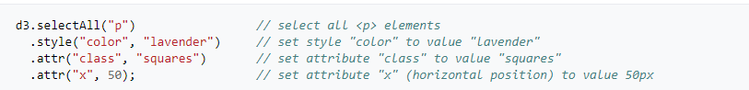
Selections
Notes:
The central principle of D3.js design is to enable the programmer to first use a CSS-style selector to select a given set of Document Object Model (DOM) nodes, then use operators to manipulate them in a similar manner to jQuery. For example, by using D3.js, one may select all HTML <p>...</p> elements, and then change their text color, e.g. to lavender:

Slide 25
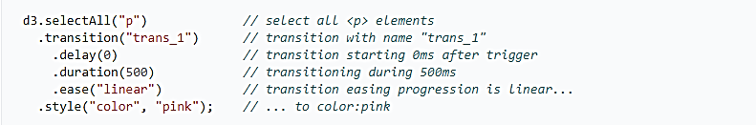
Transitions
Notes:
By declaring a transition, values for attributes and styles can be smoothly interpolated over a certain time. The following code will make all HTML <p>...</p> elements on a page gradually change their text color to pink:

Slide 26
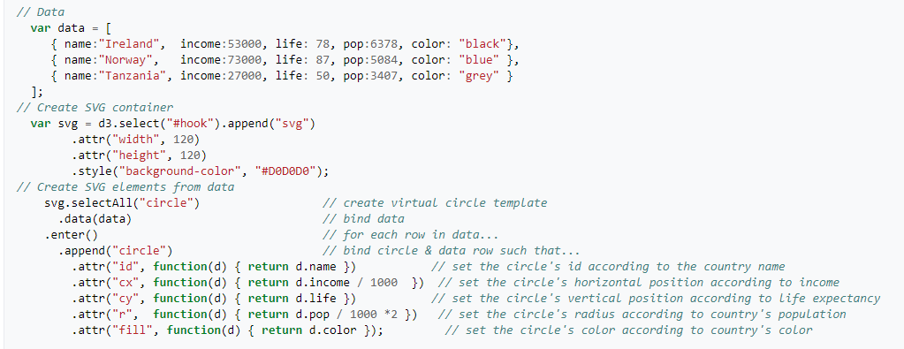
Data-binding
Notes:
For more advanced uses, loaded data drives the creation of elements. D3.js loads a given dataset, then, for each of its elements, creates an SVG object with associated properties (shape, colors, values) and behaviors (transitions, events).
Generated SVG graphics are designed according to the provided data.

Slide 27
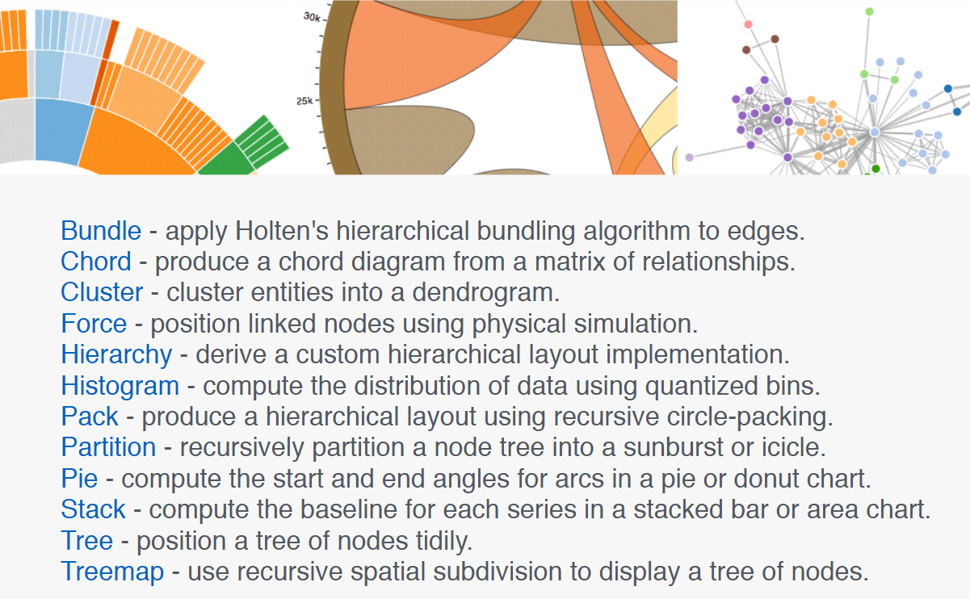
Layouts

Slide 28
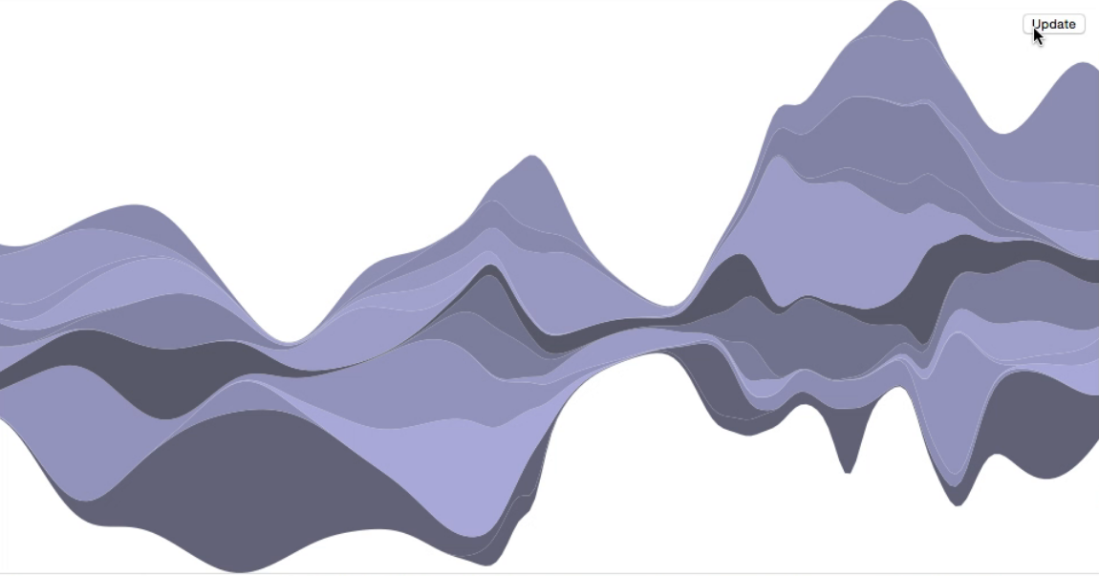
Streamgraph
Notes:
Streamgraph

Slide 29
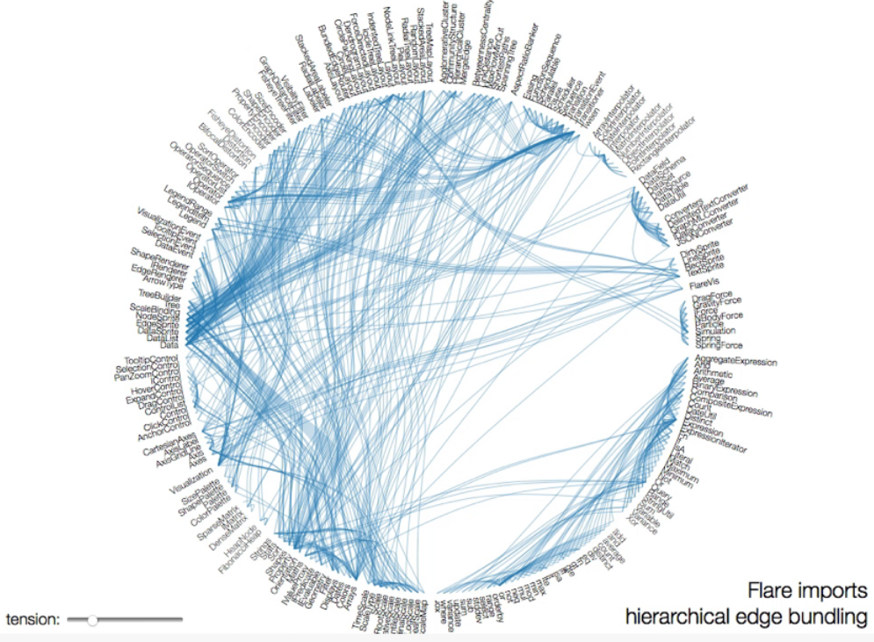
Hierarchical Edge Building

Slide 30
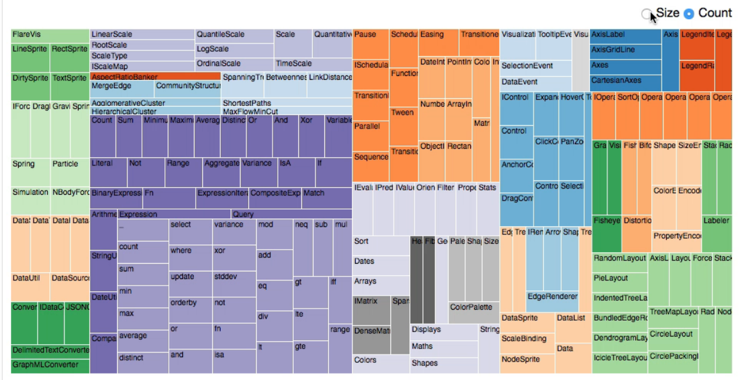
Treemap

Slide 31
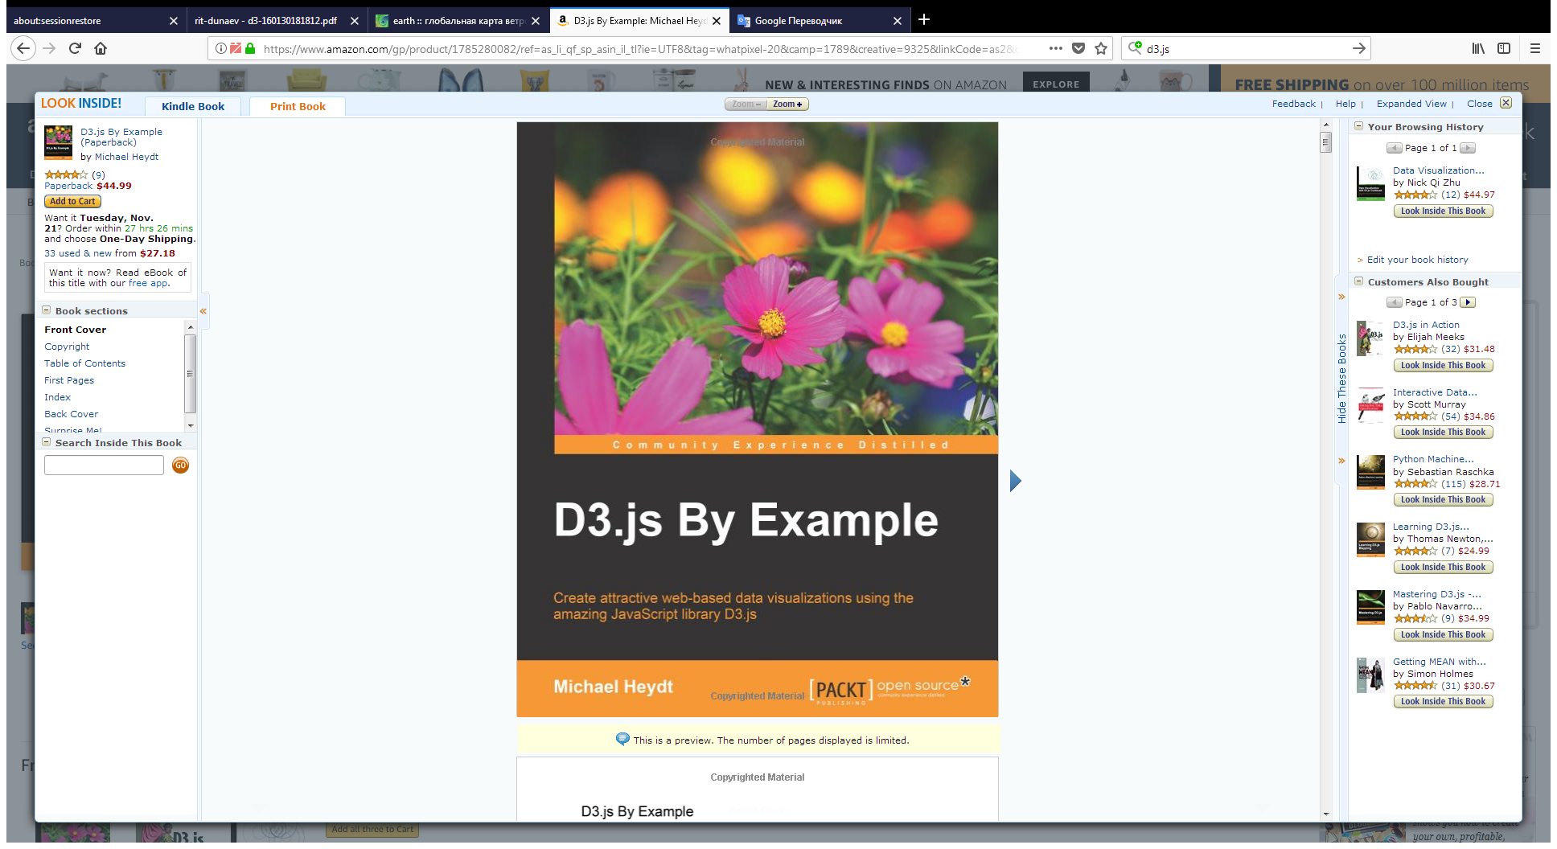
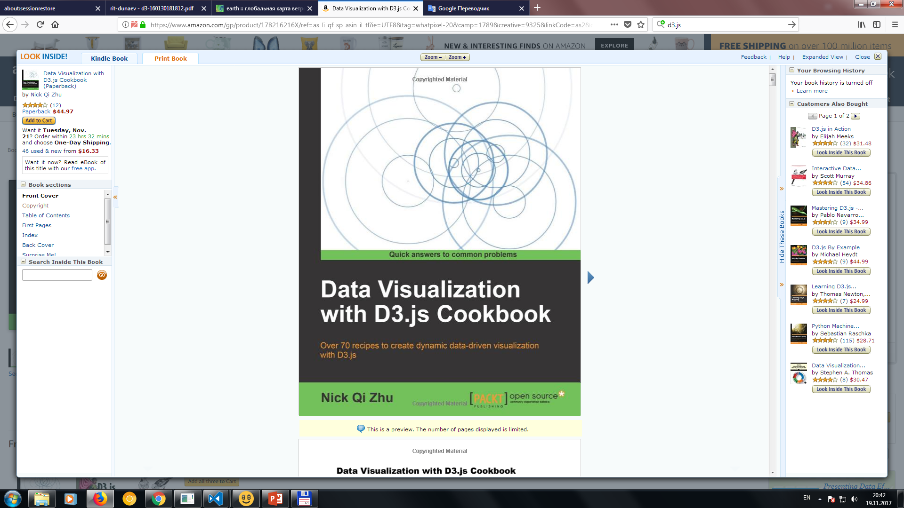
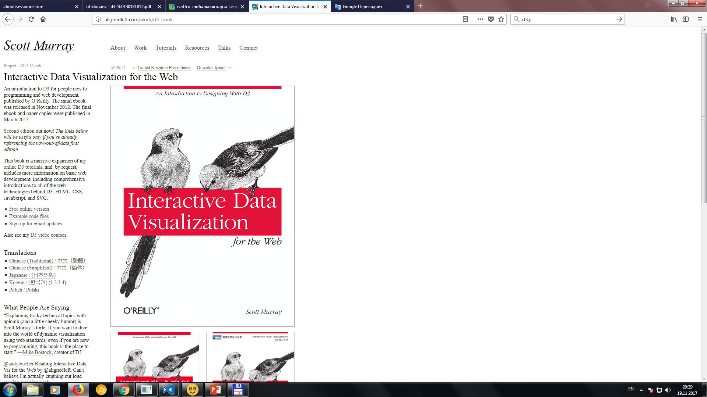
Best D3.js Books For Teaching Yourself Data Visualization with JavaScript
Notes:
Best D3.js Books For Teaching Yourself Data Visualization with JavaScript
The first book. D3.js by Example
Here’s an easy book for beginner’s. The first chapter explains the basics of D3 and how the library works. You then get into pragmatic examples of data visualization in the browser.
D3.js By Example explores how data visualization works on top of the D3.js framework. You’ll learn how to make scatter charts, maps, and how to manipulate SVG shapes. Data binding with JSON is another important topic, but JSON is easy enough to pick up as you go.
The second. Data Visualization with D3.js Cookbook
Once you’ve gone beyond the basics you’ll probably have a bunch of ideas for your own projects. Diving into the work and getting messy is the obvious thing to do. But what about working from a series of code snippets?
This is the reason I like the Data Visualization with D3.js Cookbook. It not only teaches you some fundamental topics related to D3.js, but it also provides raw source code for very common problems.
The third. Interactive Data Visualization for the Web This book by Scott Murray will get you started on the path to expertise. You can study from over 100 unique code examples and learn everything from basic graphs to animation and geomapping. I’d highly recommend this to anyone in the beginner-to-intermediate stage of D3.js.

Slide 32
Total: - just - fast - beautiful

Slide 33
THANKS!
@VLADISLAVBARANOV

